Slide 1

PaliGemma – Google's Cutting-Edge Open Vision Language Model

Slide 2

01
Introduction

Slide 3
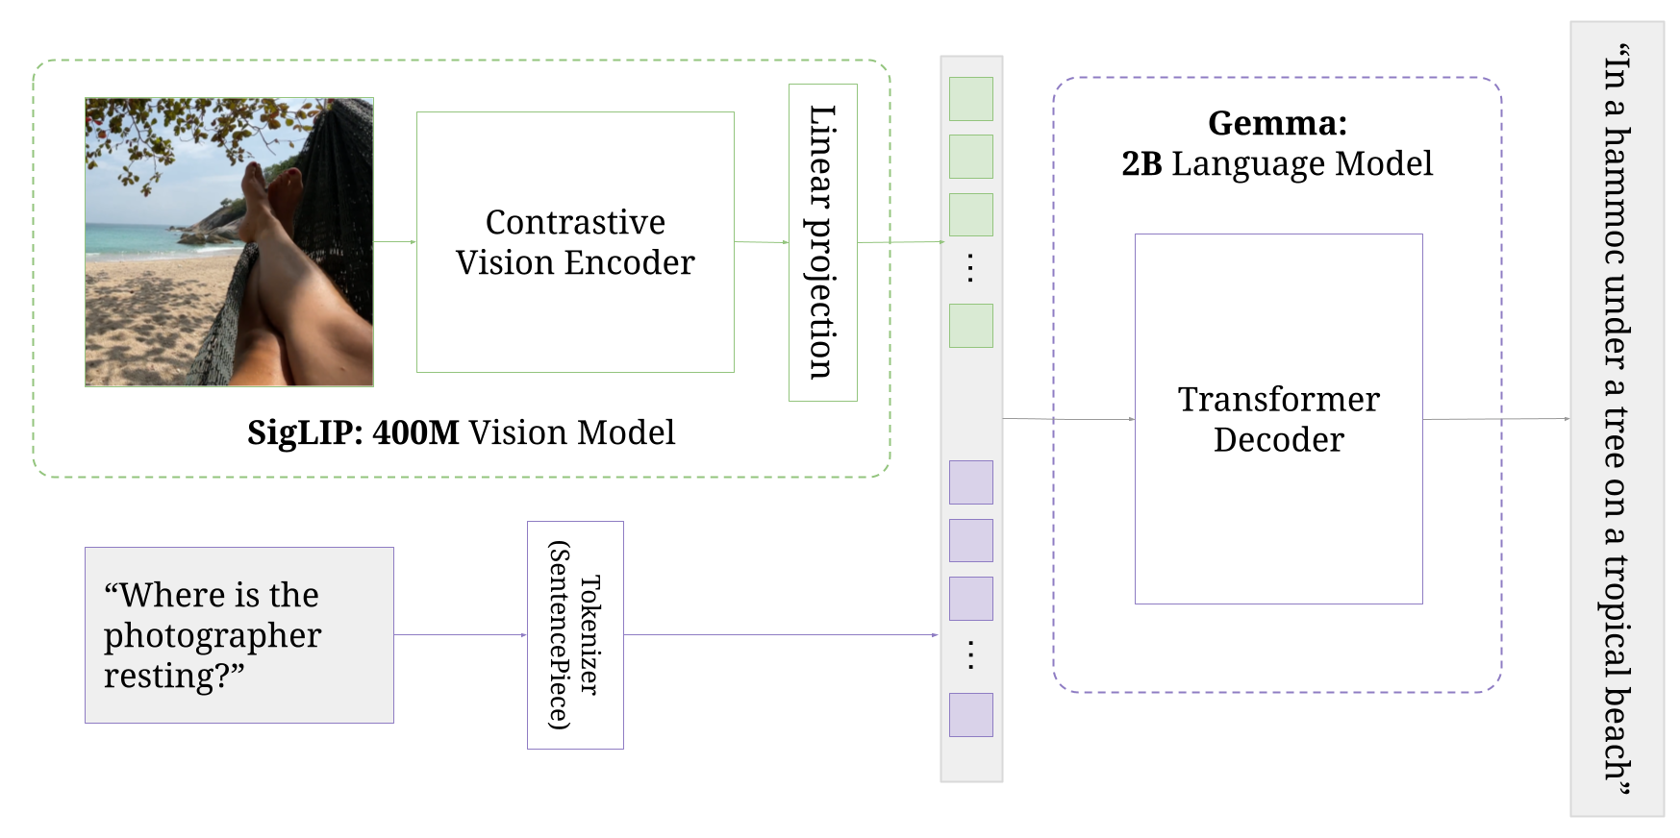
What is Paligemma?
PaliGemma is an open vision-language model (VLM)
Inspired by PaLI-3 built with open components
SigLIP vision model
Gemma language model.
Notes:
PaliGemma is an open vision-language model (VLM) inspired by PaLI-3, built with open components, such as the SigLIP vision model and the Gemma language model.
https://github.com/google-research/big_vision/blob/main/big_vision/configs/proj/paligemma/README.md

Slide 4
What is Paligemma?
PaliGemma is the composition of a
Vision Transformer (Image encoder)
Initialized from SigLIP-So400m/14
Transformer decoder (Text Decoder)
Initialized from Gemma-2B
Total of 3 billion params
PaliGemma is trained following the PaLI-3 recipes.
Notes:
PaliGemma is the composition of a Transformer decoder and a Vision Transformer image encoder, with a total of 3 billion params. The text decoder is initialized from Gemma-2B. The image encoder is initialized from SigLIP-So400m/14. PaliGemma is trained following the PaLI-3 recipes.
https://github.com/google-research/big_vision/blob/main/big_vision/configs/proj/paligemma/README.md
https://huggingface.co/google/paligemma-3b-pt-448

Slide 5
What is Paligemma?
OUTPUT
INPUT
Input: Image and text string
prompt to caption the image
a question.
Output: Generated text in response to the input
caption of the image
an answer to a question
a list of object bounding box coordinates
segmentation codewords
Image + Text String
Generated Text In response to the input
Notes:
Inputs and outputs
Input: Image and text string, such as a prompt to caption the image, or a question.
Output: Generated text in response to the input, such as a caption of the image, an answer to a question, a list of object bounding box coordinates, or segmentation codewords.
https://github.com/google-research/big_vision/blob/main/big_vision/configs/proj/paligemma/README.md
https://huggingface.co/google/paligemma-3b-pt-448

Slide 6
02
Use Cases

Slide 7
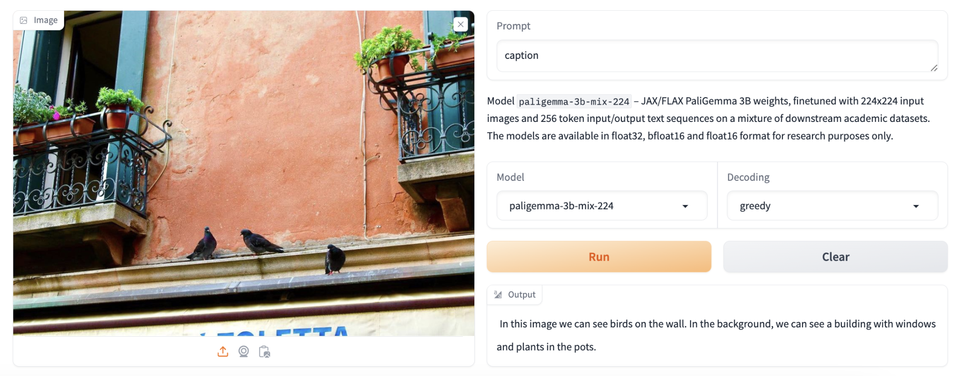
Image Captioning

Slide 8
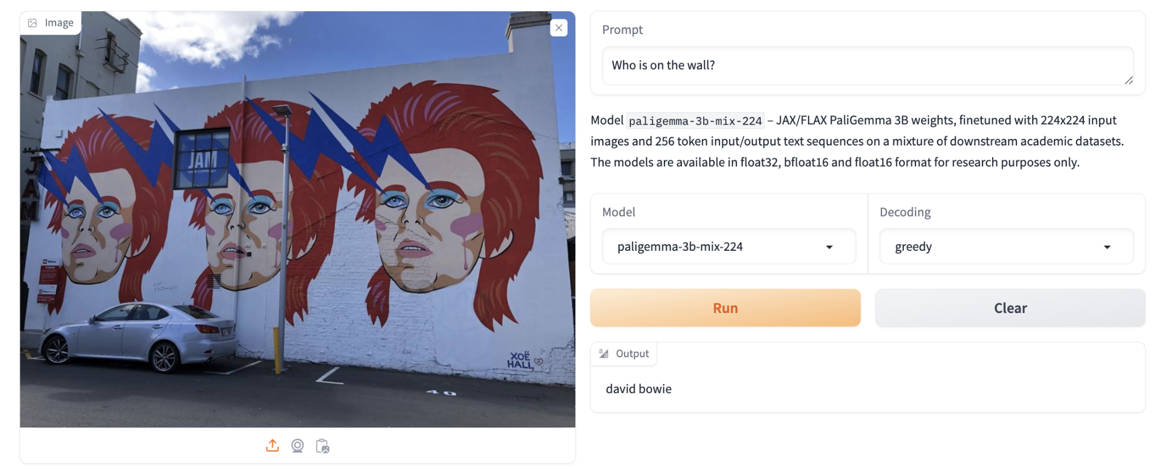
Visual Question Answering

Slide 9
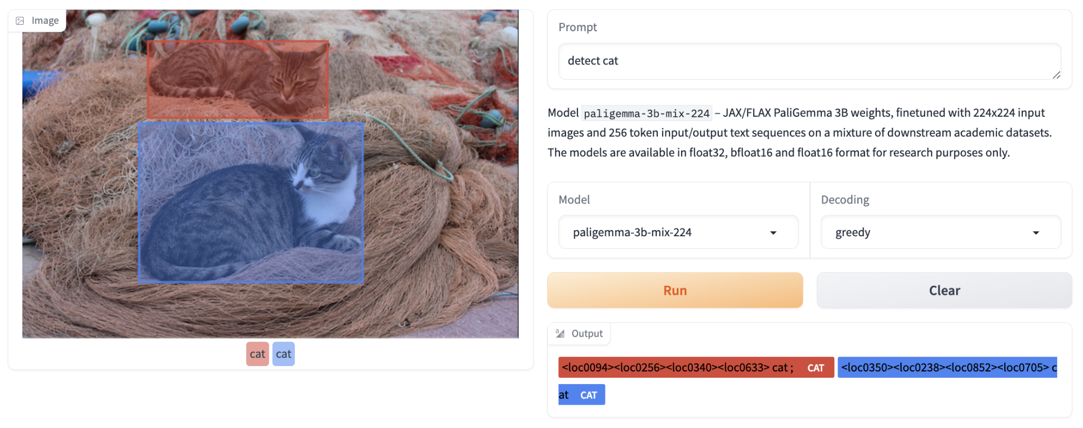
Detection

Slide 10
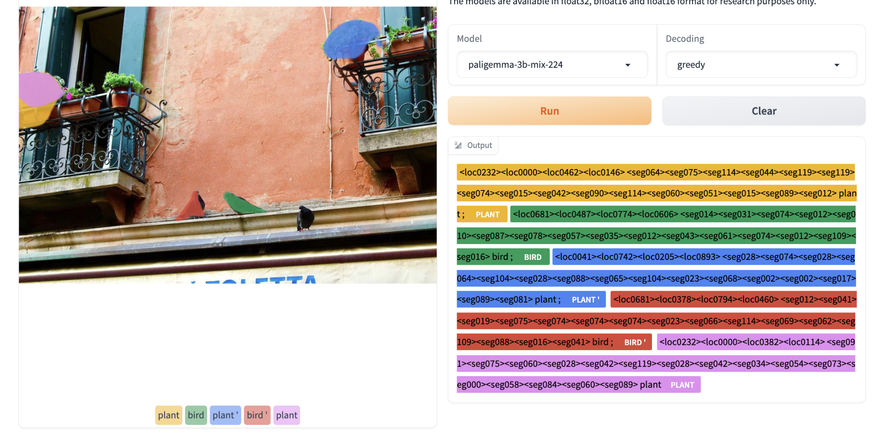
Referring Expression Segmentation

Slide 11
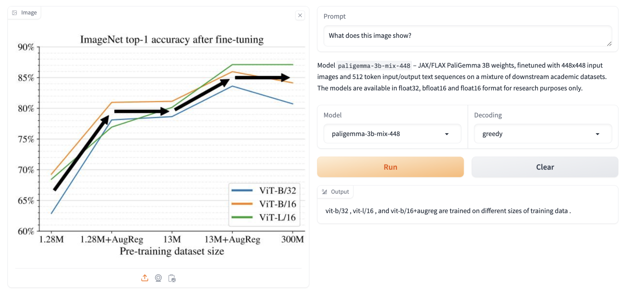
Document Understanding

Slide 12
DEMO

Slide 13
03
Finetuning Code (Using Transformers)
Notes:
https://github.com/NielsRogge/Transformers-Tutorials/blob/master/PaliGemma/Fine_tune_PaliGemma_for_image_%3EJSON.ipynb

Slide 14
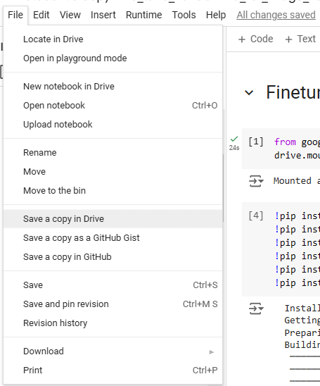
Save a Copy in Drive
Notes:
https://www.datature.io/blog/introducing-paligemma-googles-latest-visual-language-model

Slide 15
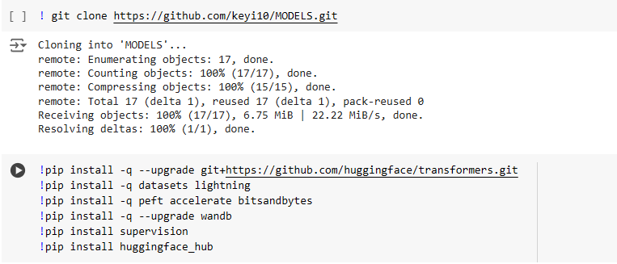
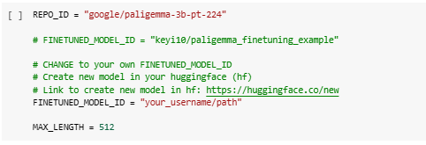
Installations/Define Variables
MAX_LENGTH is a variable that specifies the maximum number of tokens that the tokenizer will process for each input sequence.
Researchers performed pre-trainings for 448x448 and 896x896 input image resolutions and a text sequence length of 512 tokens. The training data as the previous stage is the same, but it is subsequently re-weighted with more emphasis on training examples with a higher resolution or longer sequence length.
Notes:
https://www.datature.io/blog/introducing-paligemma-googles-latest-visual-language-model

Slide 16
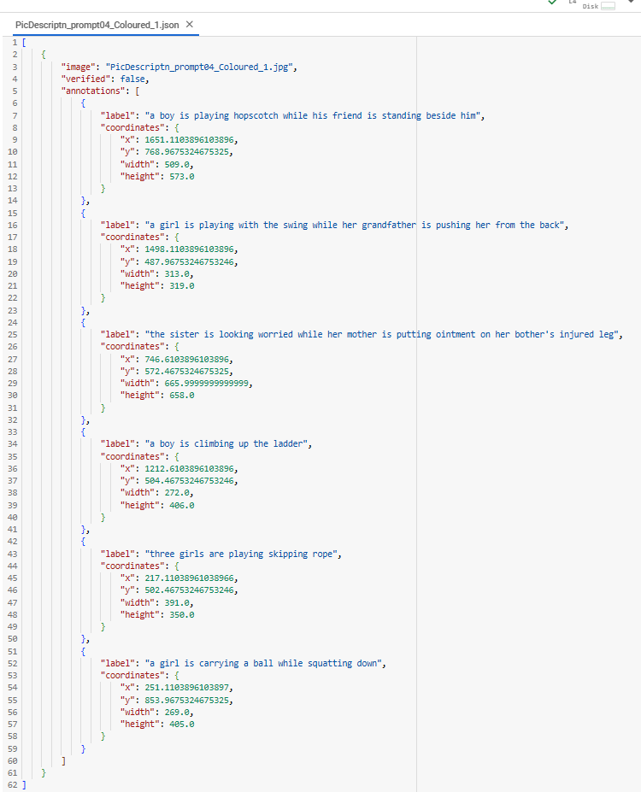
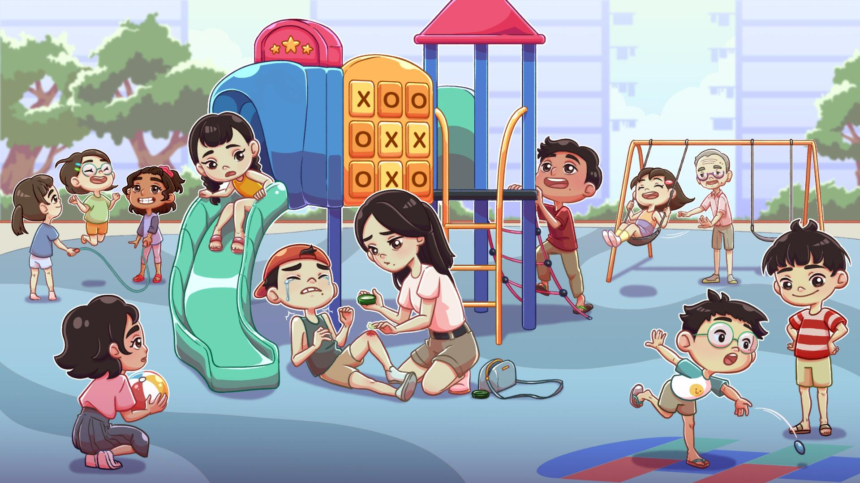
Preparation of Data
Image file
JSON file

Slide 17
Preparation of Data
A dataset in JSONL format has each line as a separate JSON object, like a list of individual records.
Each record contains the
path/name of the associated image
a prefix (prompt) that will be passed to the model
a suffix (expected response) from the model
{"image": "/path/to/the/image/all_images/PicDescriptn_prompt04_Coloured_1.jpg",
"prefix": "detect three girls are playing skipping rope ",
"suffix": "<loc0310><loc0011><loc0642><loc0220> three girls are playing skipping rope"}
Notes:
A dataset in JSONL format has each line as a separate JSON object, like a list of individual records.
Each record contains the
path/name of the associated image,
a prefix (prompt) that will be passed to the model, and
a suffix (expected response) from the model. https://blog.roboflow.com/how-to-fine-tune-paligemma/

Slide 18
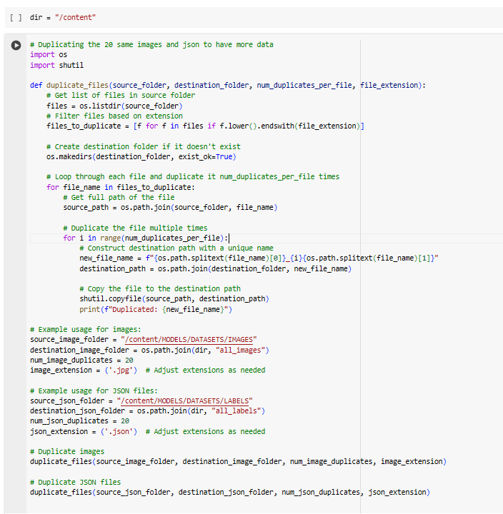
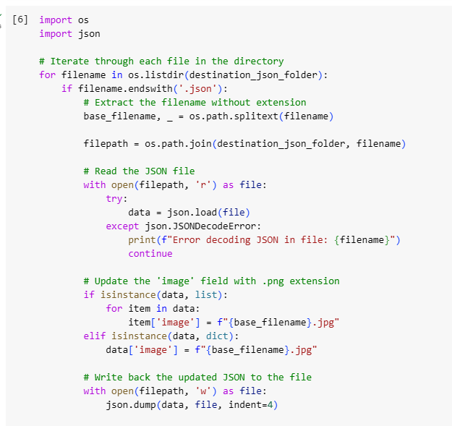
Preparation of Data

Slide 19
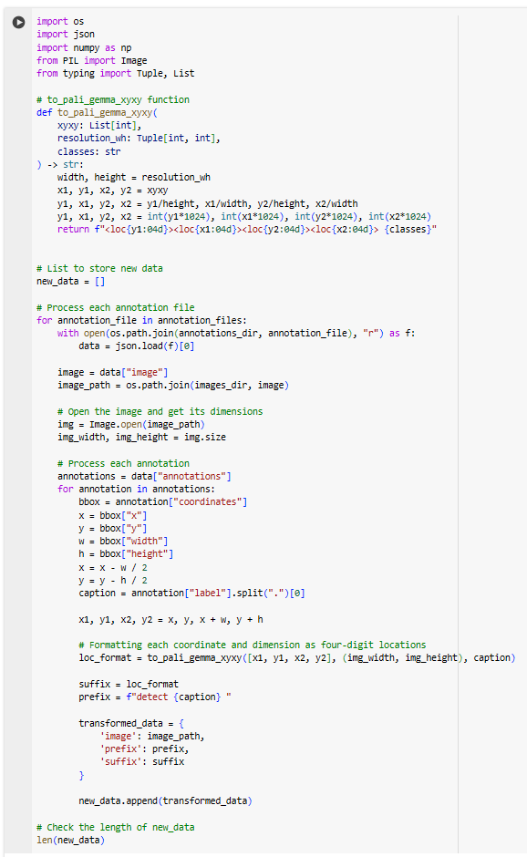
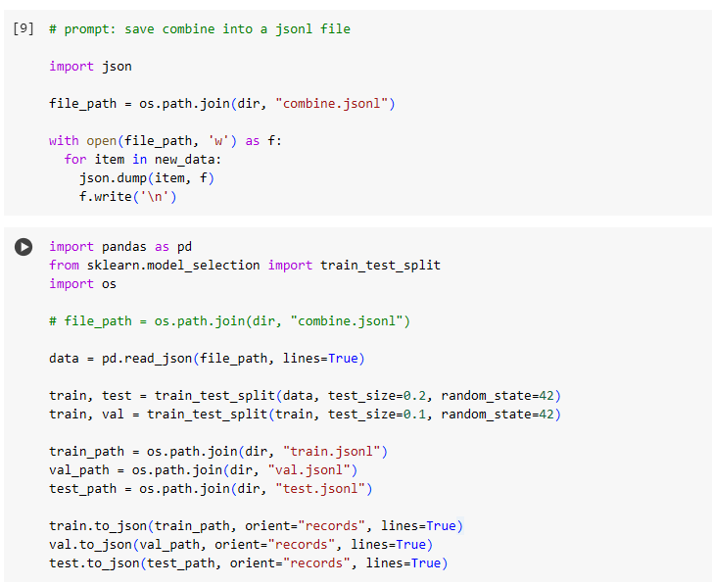
Preparation of Data
2) Write into JSONL format file
3) Split into train,val,test
1) Reformat

Slide 20
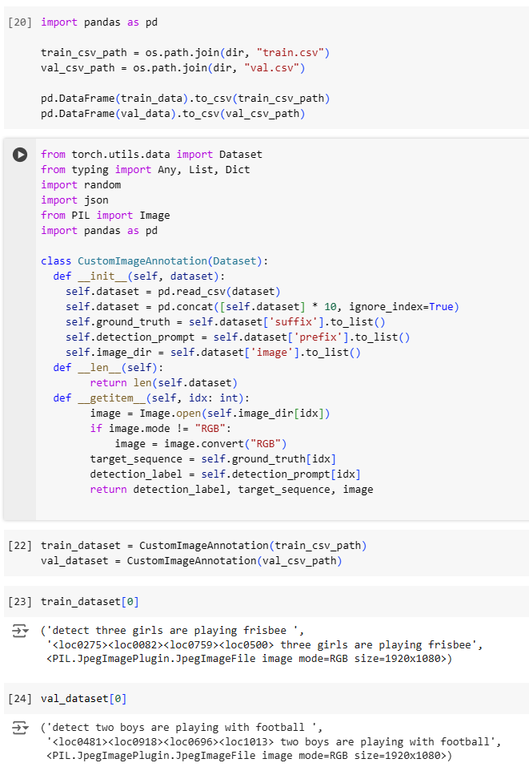
Preparation of Data

Slide 21
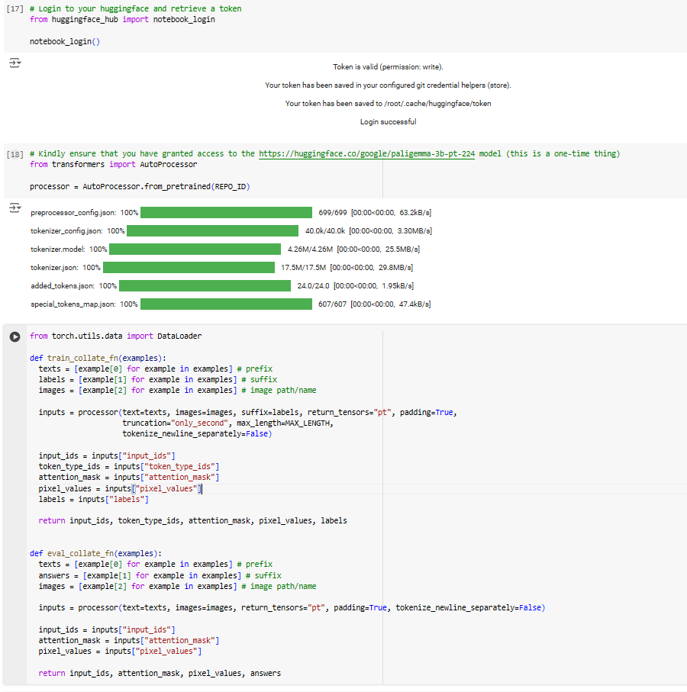
Collate Function
Notes:
from torch.utils.data import DataLoader
# Collate function for training
def train_collate_fn(examples):
# Extract the prefix texts, suffix labels, and image paths/names from the examples
texts = [example[0] for example in examples] # Prefix (e.g., text input)
labels = [example[1] for example in examples] # Suffix (e.g., labels or expected output)
images = [example[2] for example in examples] # Image paths/names
# Process the inputs using a processor, which typically handles tokenization and image preprocessing
inputs = processor(
text=texts,
images=images,
suffix=labels,
return_tensors="pt", # Return PyTorch tensors
padding=True, # Pad sequences to the same length
truncation="only_second", # Truncate only the second sequence (useful for sequence pair tasks)
max_length=MAX_LENGTH, # Maximum length of the sequences
tokenize_newline_separately=False # Tokenize the entire text as a single sequence, not line by line
)
# Extract the processed inputs
input_ids = inputs["input_ids"] # Tokenized input IDs
token_type_ids = inputs["token_type_ids"] # Segment token indices for distinguishing sequences
attention_mask = inputs["attention_mask"] # Mask to avoid performing attention on padding tokens
pixel_values = inputs["pixel_values"] # Processed image data
labels = inputs["labels"] # Processed labels (usually tokenized)
# Return the processed data as a tuple for the DataLoader
return input_ids, token_type_ids, attention_mask, pixel_values, labels
# Collate function for evaluation
def eval_collate_fn(examples):
# Extract the prefix texts, suffix answers, and image paths/names from the examples
texts = [example[0] for example in examples] # Prefix (e.g., text input)
answers = [example[1] for example in examples] # Suffix (e.g., expected answers or output)
images = [example[2] for example in examples] # Image paths/names
# Process the inputs using a processor, which typically handles tokenization and image preprocessing
inputs = processor(
text=texts,
images=images,
return_tensors="pt", # Return PyTorch tensors
padding=True, # Pad sequences to the same length
tokenize_newline_separately=False # Tokenize the entire text as a single sequence, not line by line
)
# Extract the processed inputs
input_ids = inputs["input_ids"] # Tokenized input IDs
attention_mask = inputs["attention_mask"] # Mask to avoid performing attention on padding tokens
pixel_values = inputs["pixel_values"] # Processed image data
# Return the processed data and answers as a tuple for the DataLoader
return input_ids, attention_mask, pixel_values, answers

Slide 22
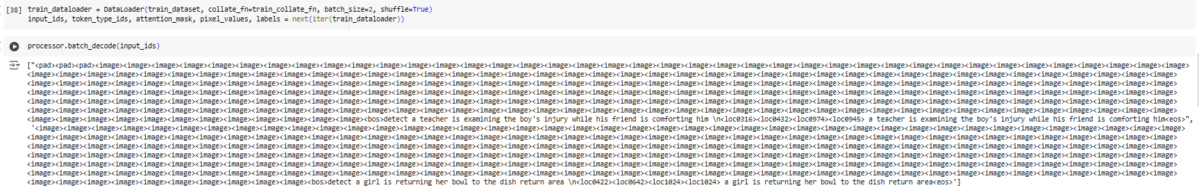
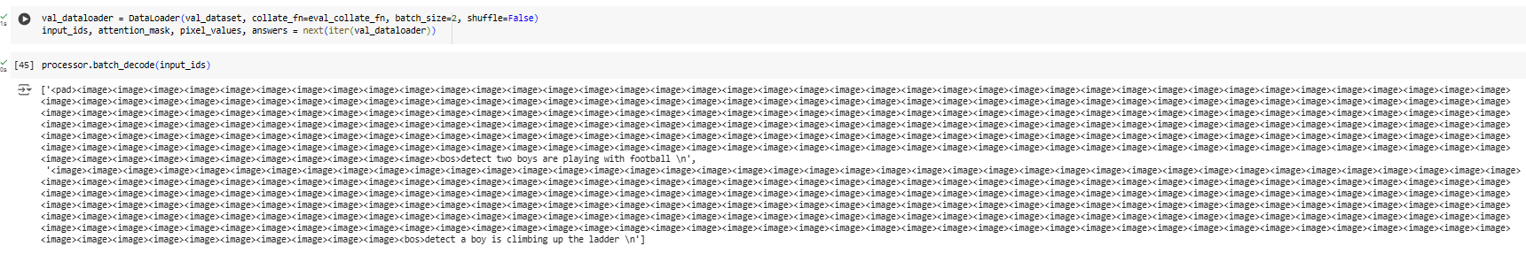
Collate Function
train
val

Slide 23
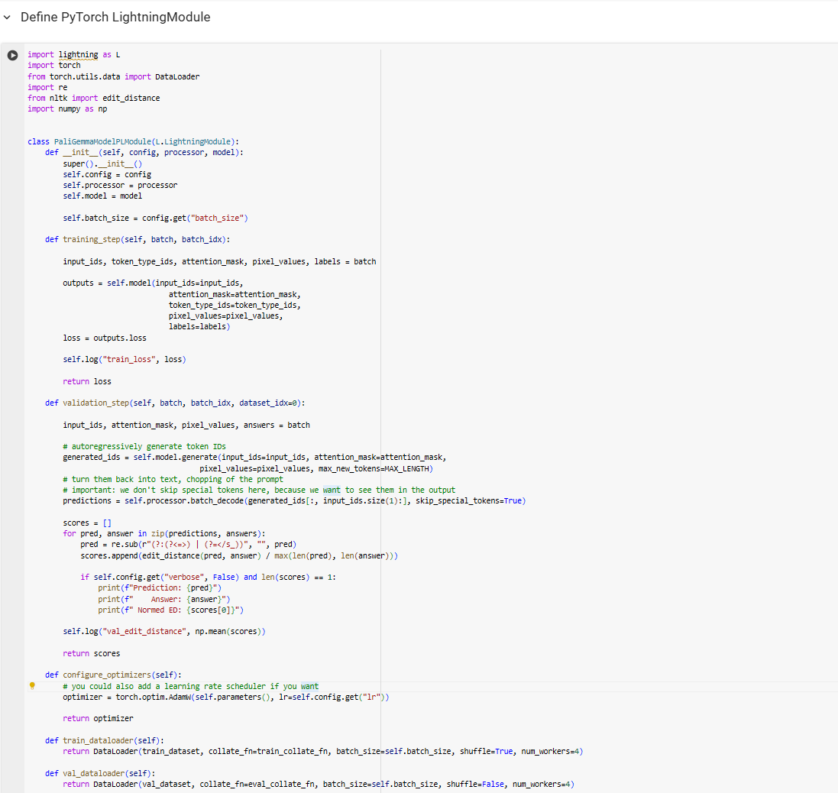
PyTorch LightningModule

Slide 24
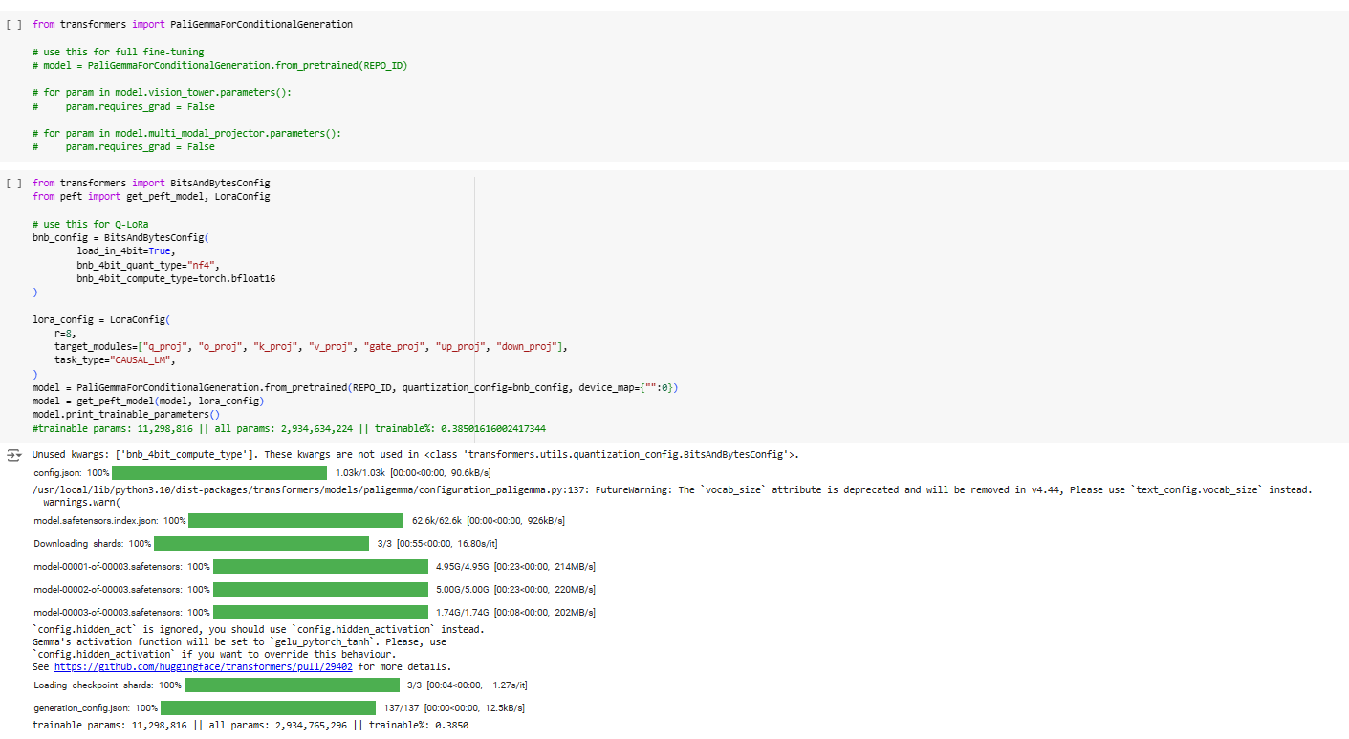
Load Model

Slide 25
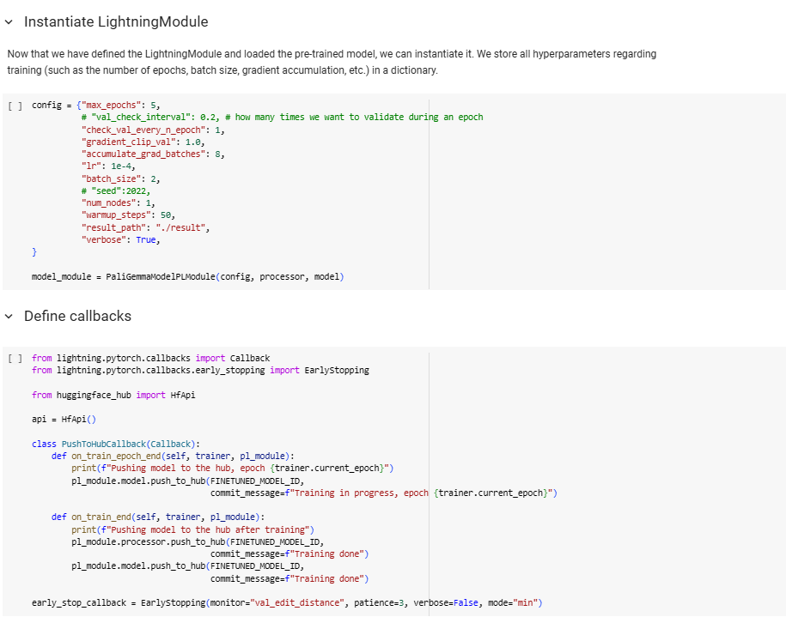
Instantiate Lightning Module

Slide 26
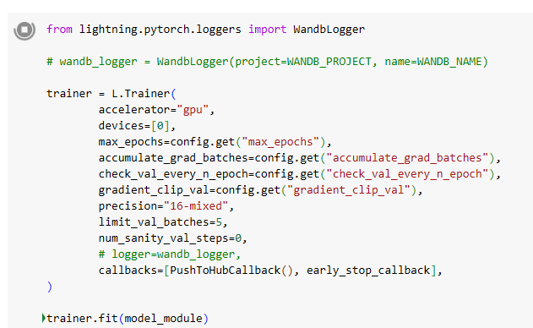
TRAINING!

Slide 27
04
Inference
Code

Slide 28
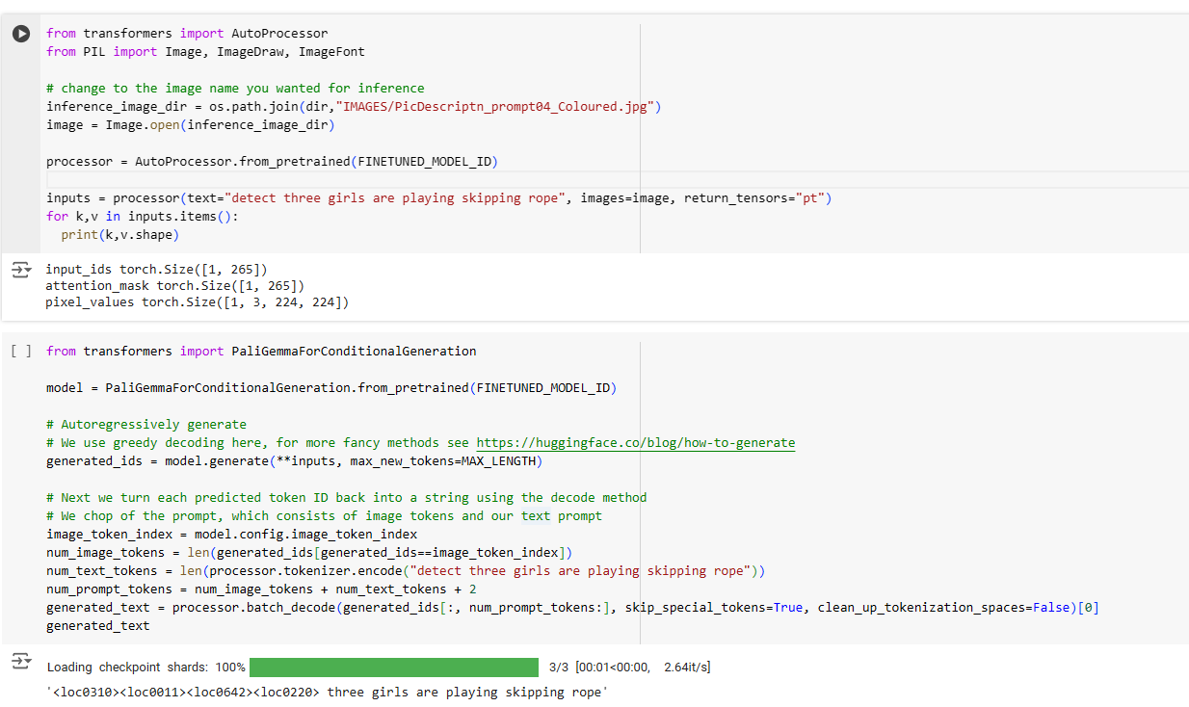
Inference

Slide 29
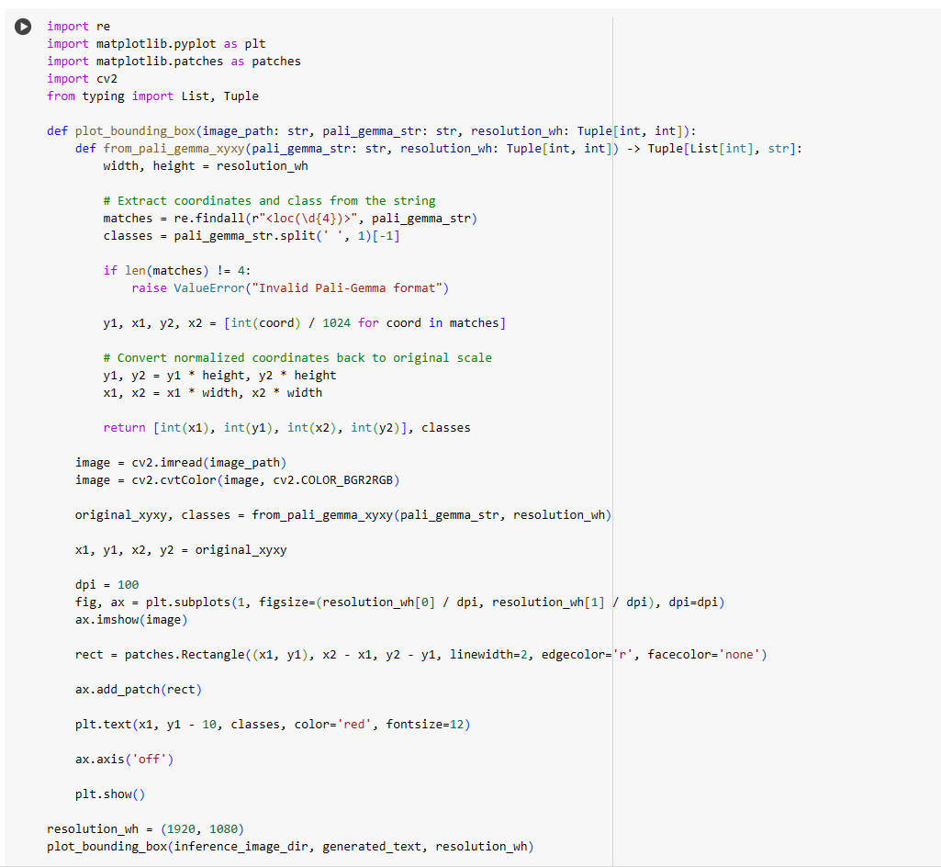
Inference - Plotting

Slide 30
Thank You!

Slide 31
References
https://github.com/google-research/big_vision/blob/main/big_vision/configs/proj/paligemma/README.md
https://github.com/google-research/big_vision/blob/main/big_vision/configs/proj/paligemma/README.md
https://huggingface.co/google/paligemma-3b-pt-448
https://github.com/NielsRogge/Transformers-Tutorials/blob/master/PaliGemma/Fine_tune_PaliGemma_for_image_%3EJSON.ipynb
https://www.datature.io/blog/introducing-paligemma-googles-latest-visual-language-model

